Slide 1

HR Analytics Hackathon Classification Problem
Prepared by Mohamed Suhaib

Slide 2
Problem Statement
WNS Analytics Wizard 2018
Your client is a large MNC and they have 9 broad verticals across the organisation. One of the problem your client is facing is around identifying the right people for promotion (only for manager position and below) and prepare them in time. Currently the process, they are following is:
They first identify a set of employees based on recommendations/ past performance
Selected employees go through the separate training and evaluation program for each vertical. These programs are based on the required skill of each vertical
At the end of the program, based on various factors such as training performance, KPI completion (only employees with KPIs completed greater than 60% are considered) etc., employee gets promotion
For above mentioned process, the final promotions are only announced after the evaluation and this leads to delay in transition to their new roles. Hence, company needs your help in identifying the eligible candidates at a particular checkpoint so that they can expedite the entire promotion
They have provided multiple attributes around Employee's past and current performance along with demographics. Now, The task is to predict whether a potential promotee at checkpoint in the test set will be promoted or not after the evaluation process.

Slide 3
Scope of this project
Using this model, will try to predict whether a potential promotee at checkpoint in the test set will be promoted or not after the evaluation process

Slide 4
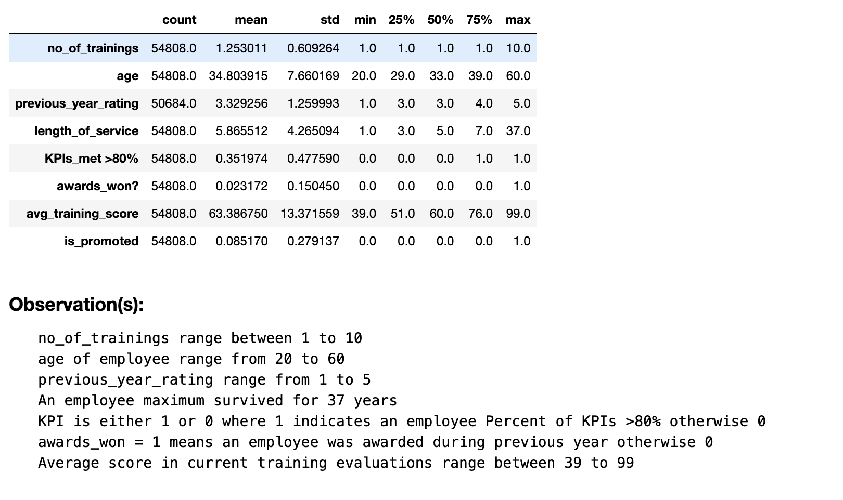
Observation:

Slide 5
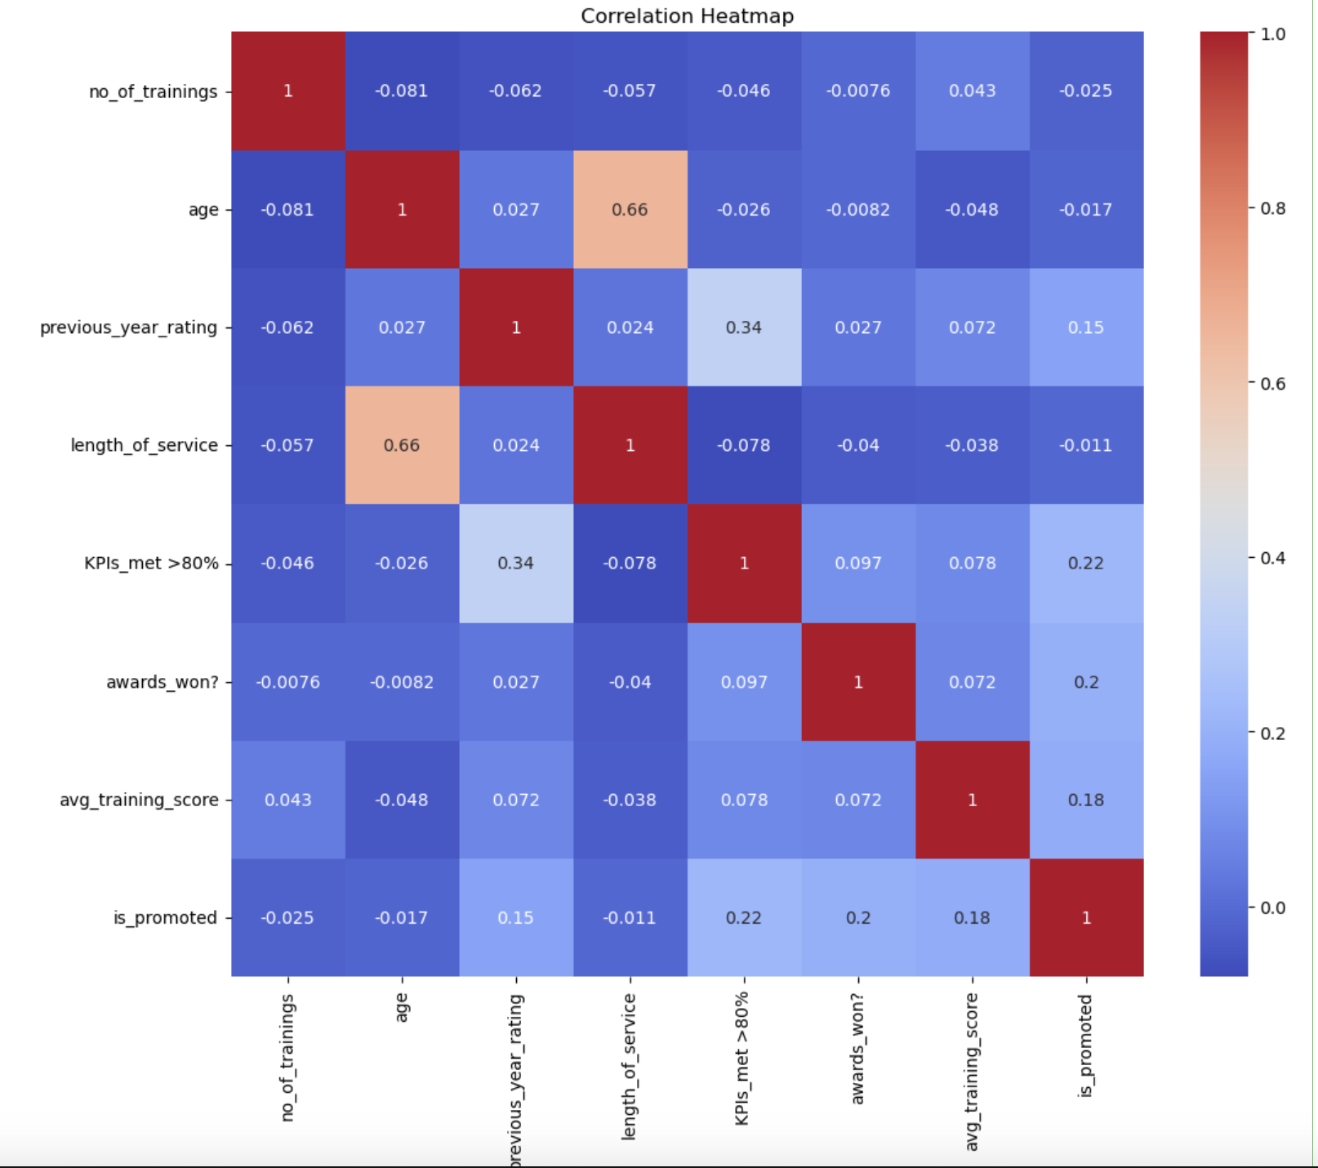
Correlation Heatmap

Slide 6
category and numeric features
Categorical Columns:
['department', 'region', 'education', 'gender', 'recruitment_channel’]
Numerical Columns:
['no_of_trainings', 'age', 'previous_year_rating', 'length_of_service', 'KPIs_met_80_percent', 'awards_won', 'avg_training_score']

Slide 7
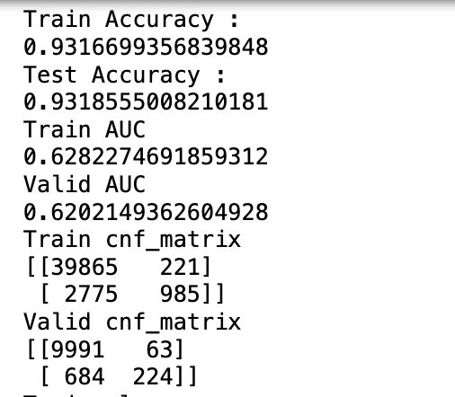
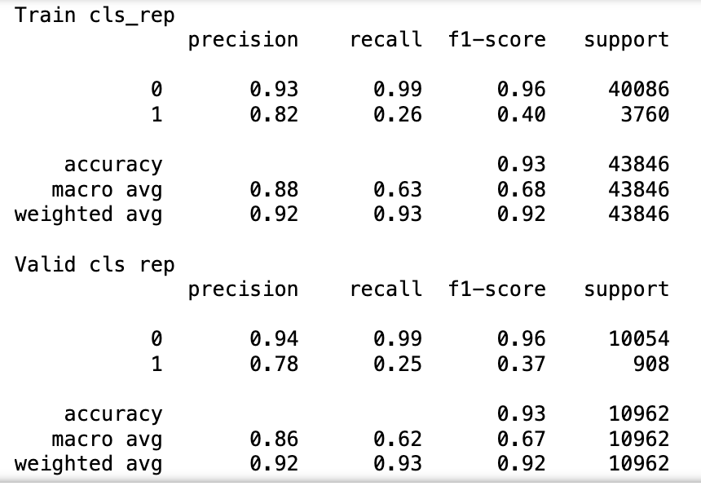
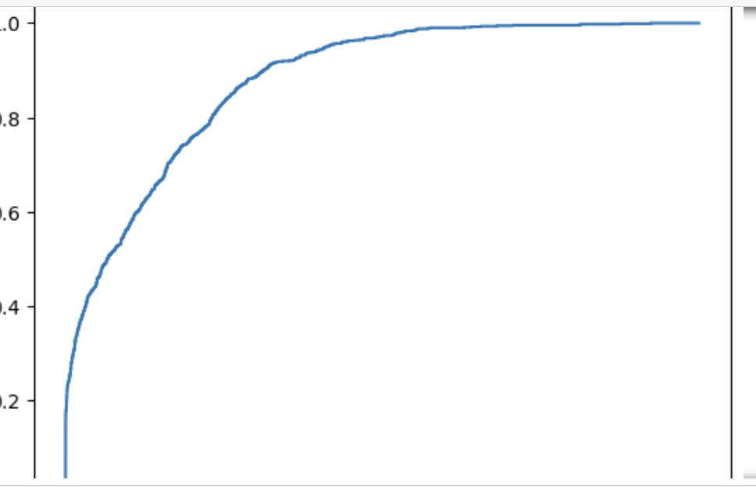
Model Comparison:
Using Logistic Regression:
Train f1 Score 0.3966975432944019
Test f1 Score 0.37489539748953976

Slide 8
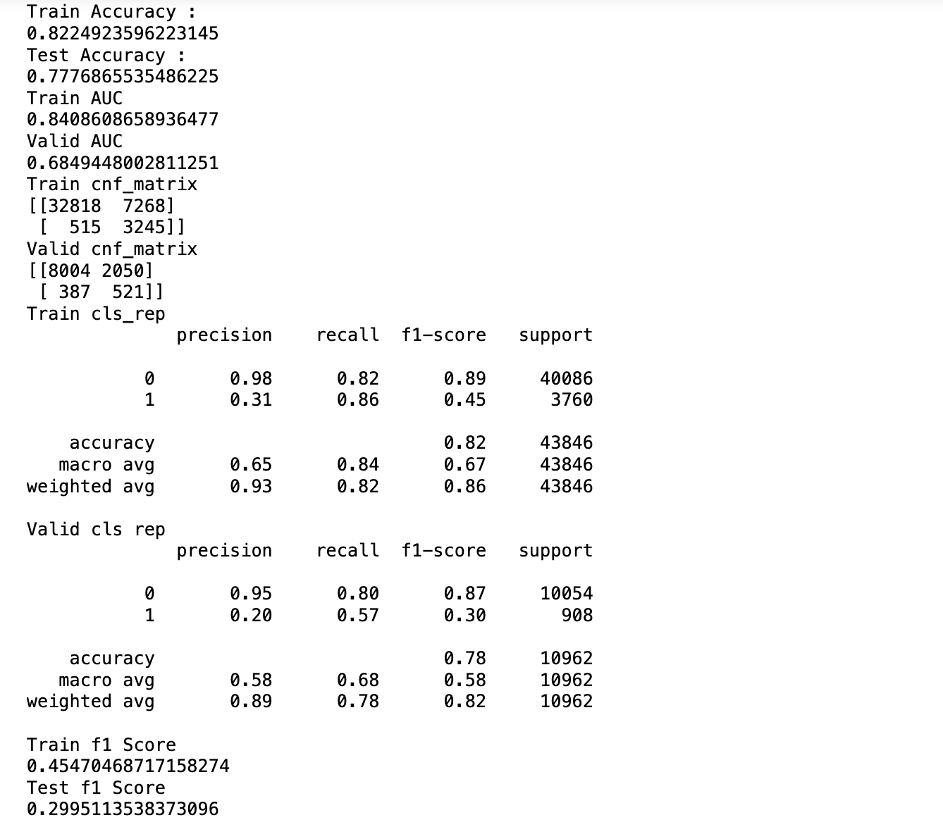
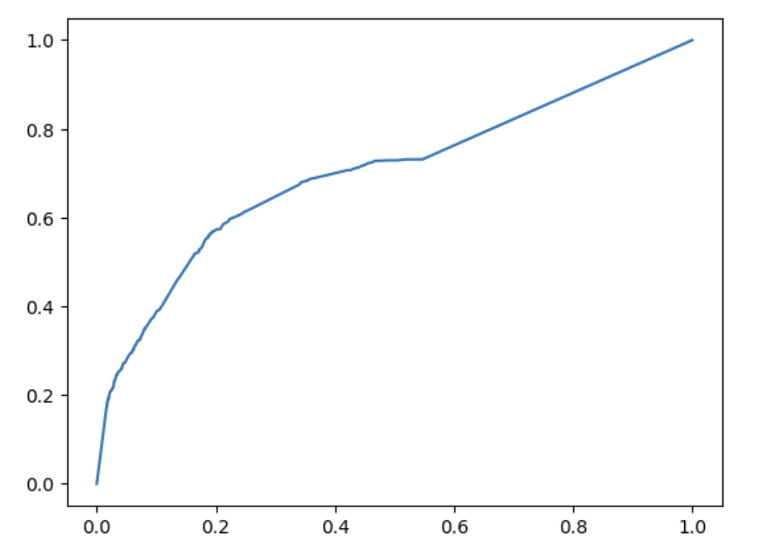
Hyperparameters Tuning for each model
Using DecisionTreeClassifier:

Slide 9
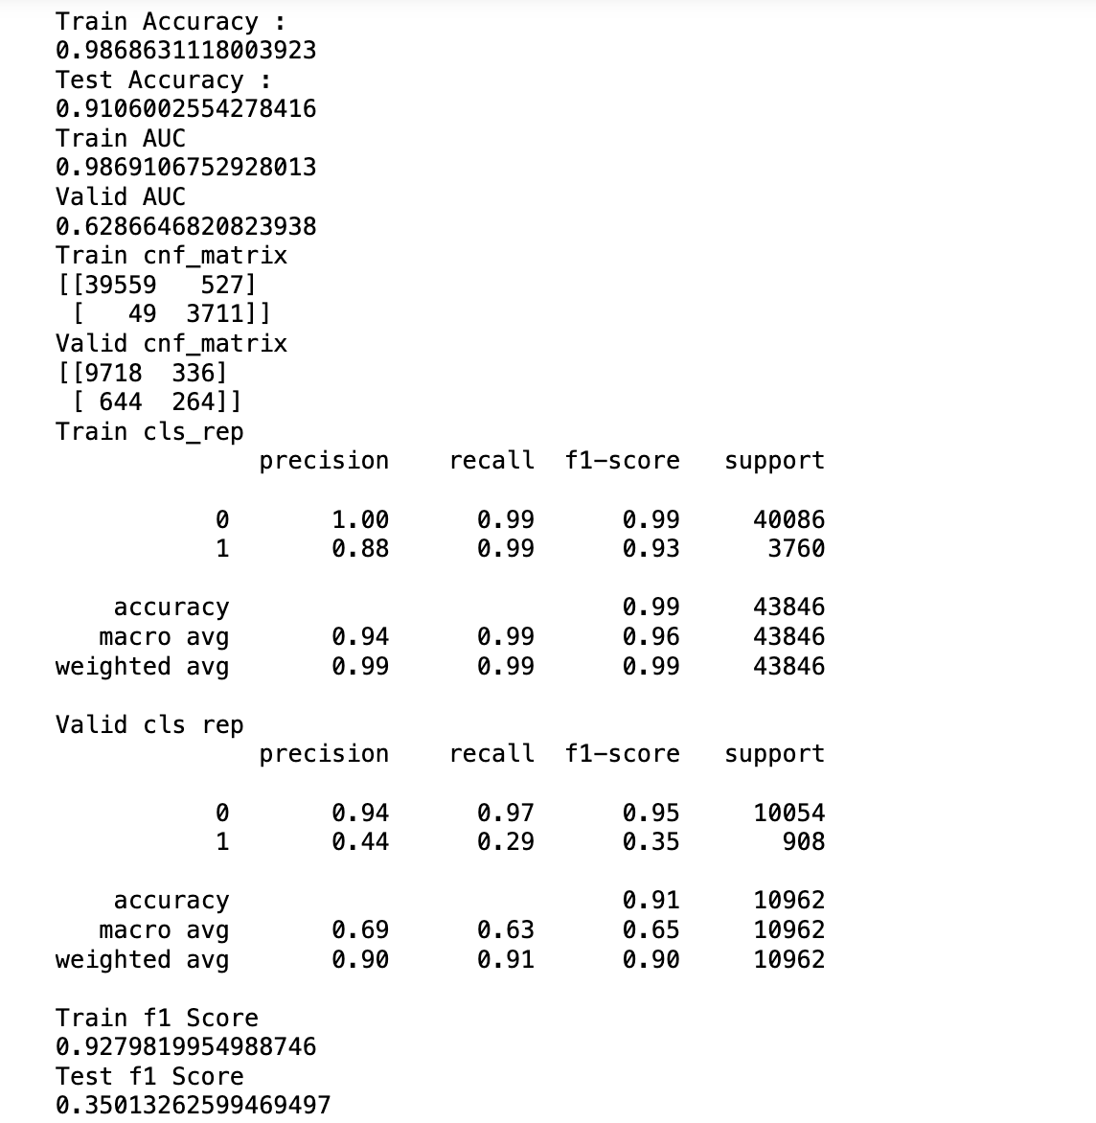
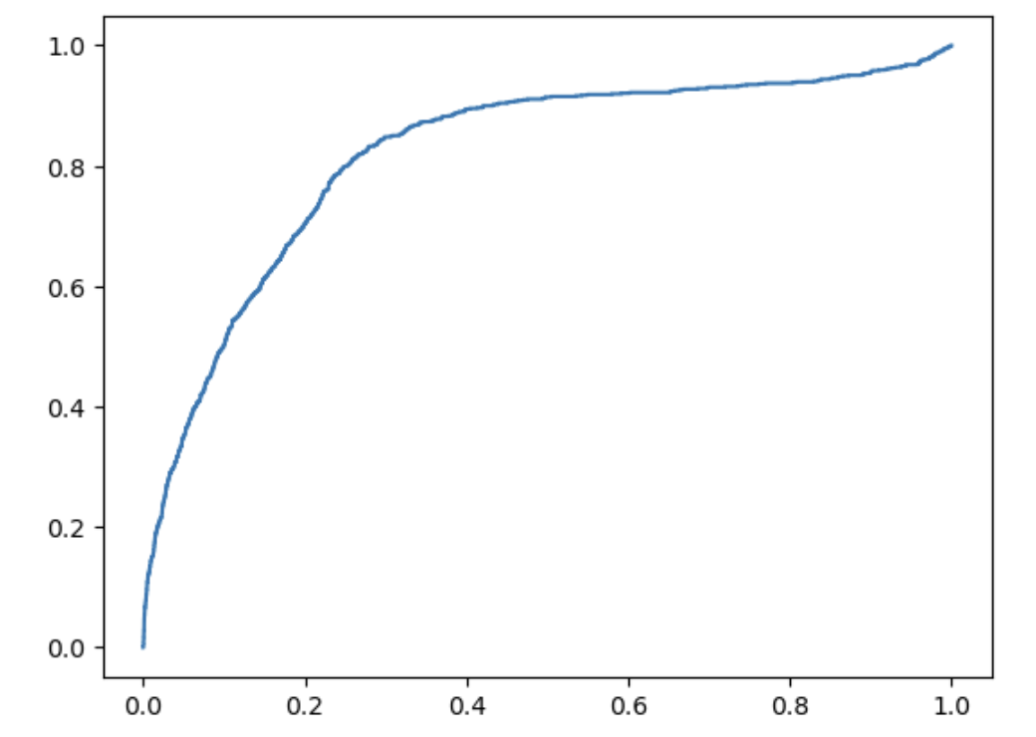
Hyperparameters Tuning for each model
Using StackingClassifier & GradientBoostingClassifier:

Slide 10
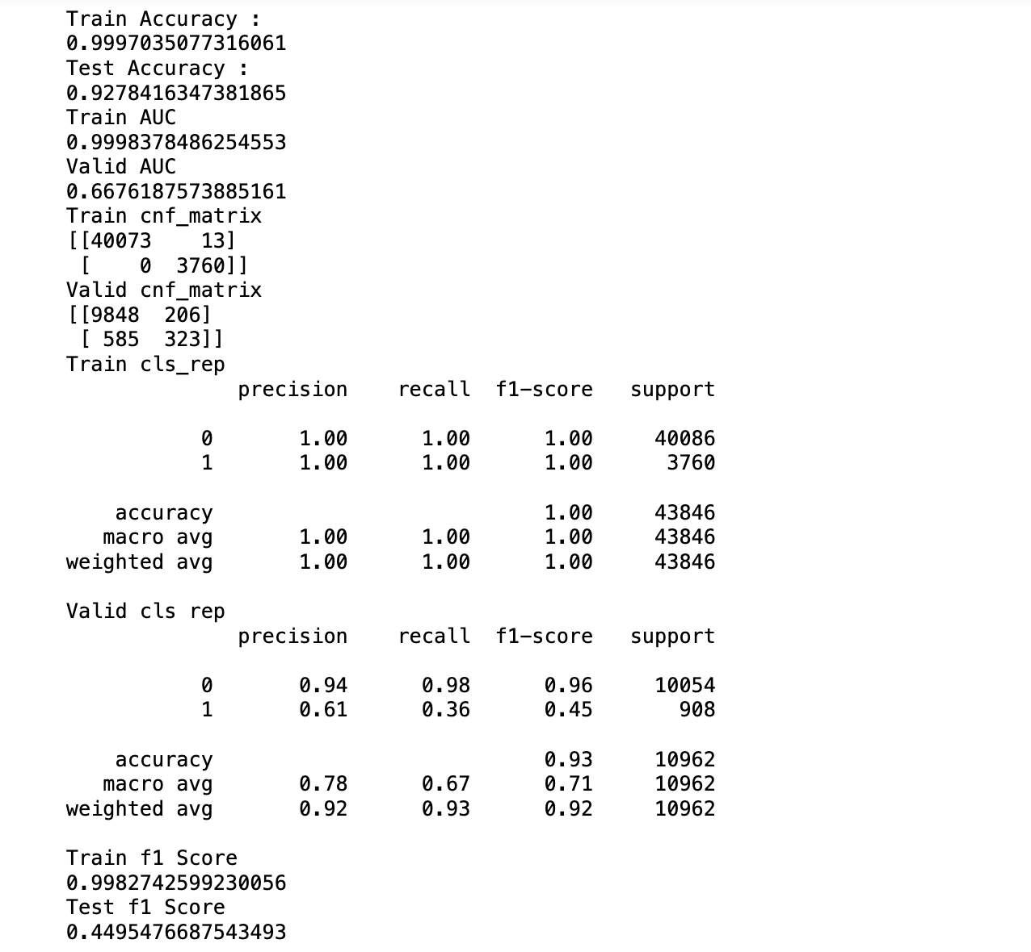
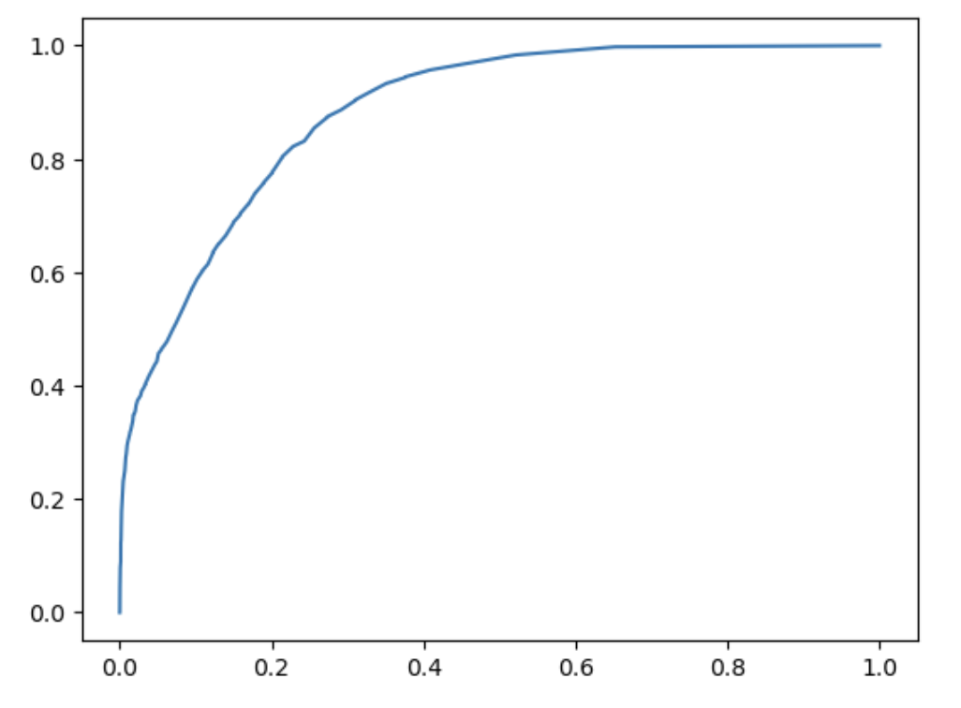
Hyperparameters Tuning for each model
Using StackingClassifier & XGBClassifier:

Slide 11
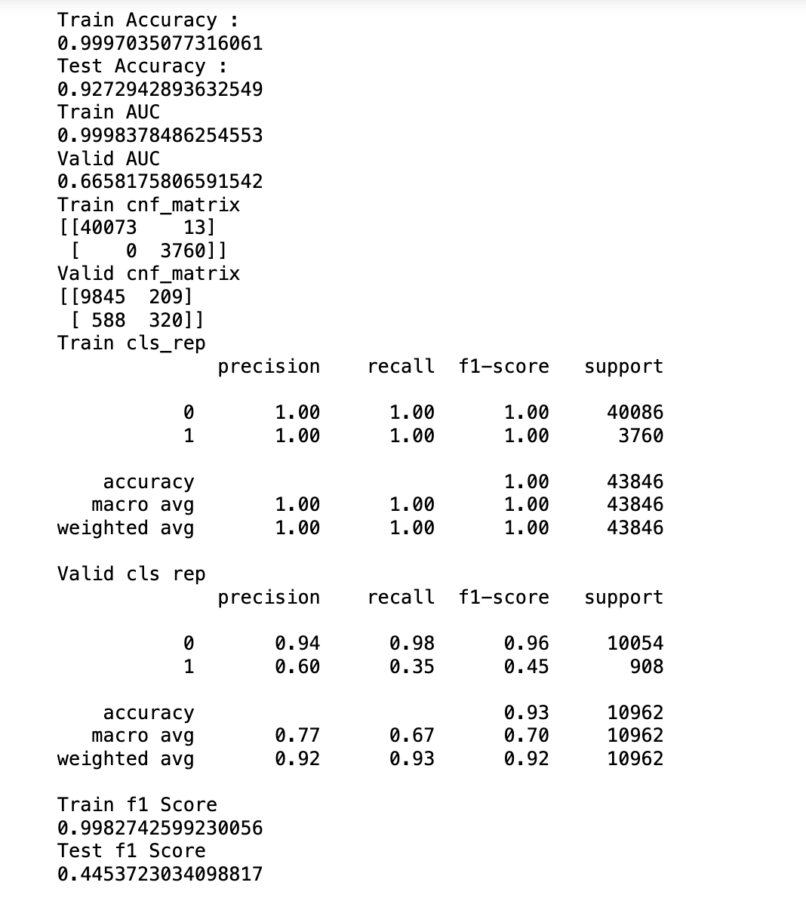
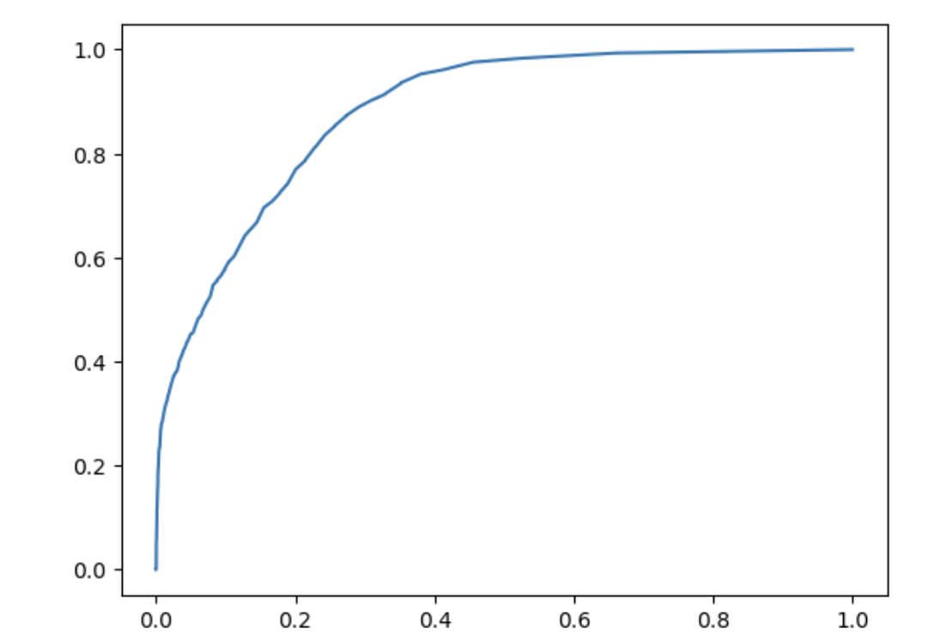
Hyperparameters Tuning for each model
Using StackingClassifier & XGBClassifier & DecisionTreeClassifier:

Slide 12

Result uploaded in the analytics vidhya website and the recieved score
Evaluation Metrics : F1 Score

